Slide 1

Hadoop and Spark on XSEDE/Bridges
credit to David Hughes, CS students, Cal Poly Pomona

Slide 2
XSEDE
IU/TACC (Jetstream) | Indiana U | compute | User Guide
IU/TACC Storage (Jetstream Storage) | Indiana U | storage | User Guide
LSU Cluster (superMIC) | LSU CCT | compute | User Guide
Open Science Grid (OSG) | OSG | compute | User Guide
PSC Bridges GPU (Bridges GPU) | PSC | compute | User Guide
PSC Large Memory Nodes (Bridges Large) | PSC | compute | User Guide
PSC Regular Memory (Bridges) | PSC | compute | User Guide
PSC Storage (Bridges Pylon) | PSC | storage | User Guide
SDSC Comet GPU Nodes (Comet GPU) | SDSC | compute | User Guide
SDSC Dell Cluster with Intel Haswell Processors (Comet) | SDSC | compute | User Guide
SDSC Medium-term disk storage (Data Oasis) | SDSC | storage | User Guide
Stanford University GPU Cluster (XStream) | Stanford U | compute | User Guide
TACC Data Analytics System (Wrangler) | TACC | compute | User Guide
TACC Dell/Intel Knights Landing, Skylake System (Stampede2) | UT Austin | compute | User Guide
TACC Long-term Storage (Wrangler Storage) | TACC | storage | User Guide
TACC Long-term tape Archival Storage (Ranch) | TACC | storage | User Guide
The Extreme Science and Engineering Discovery Environment
XSEDE is an NSF-funded virtual organization

Slide 3
Bridges
Pittsburgh Supercomputing Center (PSC) Resource
Virtual tour
https://www.psc.edu/index.php/bridges-virtual-tour
Bridges Resources
PSC Bridges GPU (Bridges GPU)
PSC Large Memory Nodes (Bridges Large)
PSC Regular Memory (Bridges)
Interact -N 4
PSC Storage (Bridges Pylon)
$SCRATCH

Slide 4
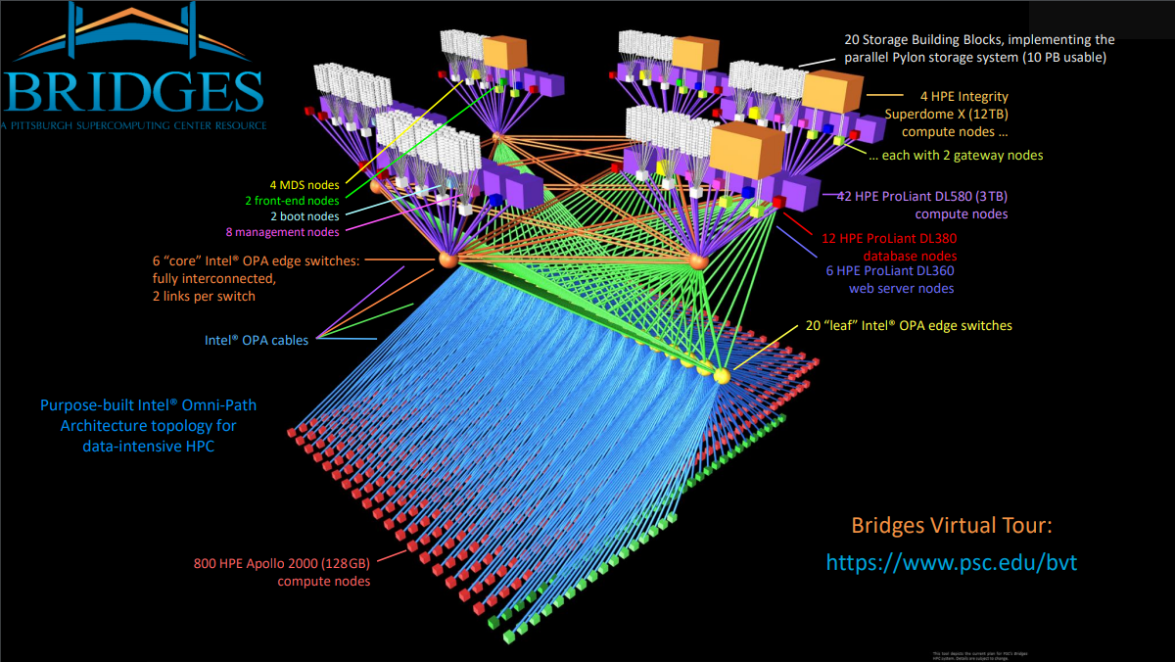
John Urbanic 2018

Slide 5
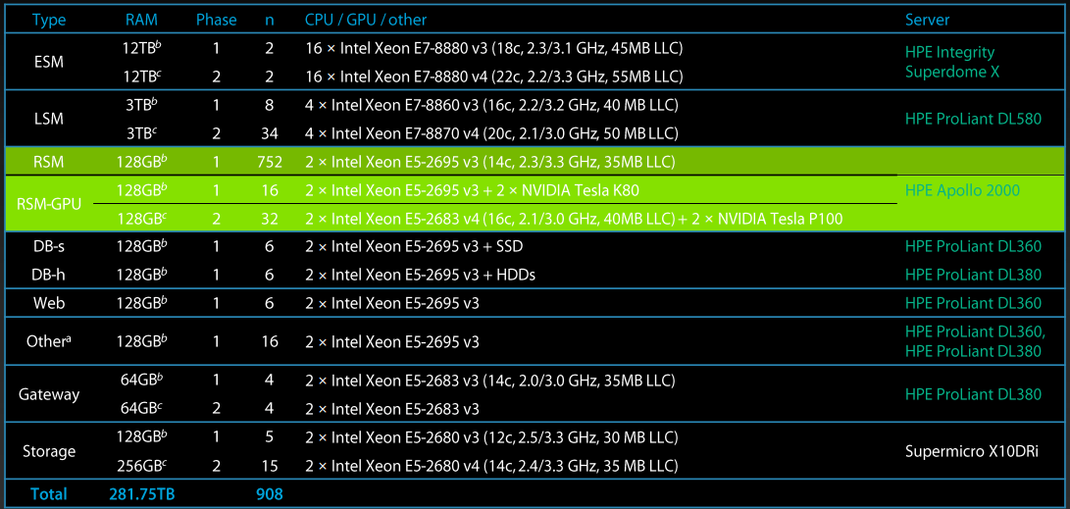
Bridges Node Types
John Urbanic 2018

Slide 6
Bridges User Guide
https://portal.xsede.org/psc-bridges
Password, connect to bridges, two-factor authentication XSEDE Duo (optional), file transfer,…
The interact command – to start a session and request computing nodes
e.g. $ interact -N 4 -t 00:30:00 # 4 nodes and 30 minutes
Note: for using Hadoop under our project resource, request 4 – 8 nodes

Slide 7
Modules
Environment management package for using certain software
Command: >module avail software-name
Example Usage: (after interact)
>module load hadoop
>start-hadoop.sh
https://www.psc.edu/user-resources/software/module
https://www.psc.edu/resources/software

Slide 8
Hadoop and Spark on Bridges
Spark
HDFS as data source
Yarn as resource management and job scheduling/monitoring
HDFS
Uses $SCRATCH disk space (pylon5)
1. Transfer files using scp/sftp
2. Use command: >hdfs dfs -put
YARN
Retrieve full output (primarily error logs)
>yarn logs -applicationId “applicationid”
interact -N 3 # wait for resources module load hadoop start-hadoop.sh
https://www.psc.edu/bridges/user-guide/hadoop-and-spark

Slide 9
Hadoop and HDFS commands
Tutorial: https://data-flair.training/blogs/top-hadoop-hdfs-commands-tutorial/
Examples
$hdfs dfs -mkdir CS4650
$Hadoop fs -cp /user/datasource/Introduction.txt CS4650
fs vs dfs
Fs used for generic file system, includiing local file system, HDFS etc.
hadoop dfs <args>
hdfs dfs <args>
dfs points to the Distributed File System and it is specific to HDFS. You may have to use hdfs dfs instead of hadoop dfs.

Slide 10
More about Hadoop and Spark

Slide 11

Hadoop
History
Open source project called Hadoop created by Doug Cutting in 2005
Based on the MapReduce paper by Google
Now Apache Hadoop
What it does
Runs using the MapReduce algorithm
Data is processed on different nodes of the cluster system
Solution for storing and processing voluminous unstructured data sets

Slide 12
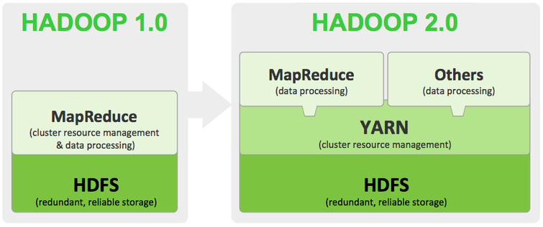
Hadoop Framework
Hadoop Common
Java libraries and utilities needed to start Hadoop
Hadoop YARN
Job Scheduling and cluster resource management
Hadoop Distributed File System (HDFS)
Distributed file system for access to application data
Hadoop MapReduce
Parallel processing of large data sets
Google

Slide 13

Apache Spark

Slide 14


Spark
Research project at UC Berkeley AMPLab
“Spark: Cluster Computing with Working Sets,” 2010
Goal: “Support a much wider class of applications than MapReduce, while maintaining automatic fault tolerance” [2]

Slide 15
Goal: “Support a much wider class of applications” [2]
Multipass applications with low-latency data sharing requirements
Common in data analytics
Iterative algorithms: machine learning and graph algorithms
Interactive data mining: load data into RAM across a cluster and query repeatedly
Streaming Applications: maintain aggregate state over time

Slide 16
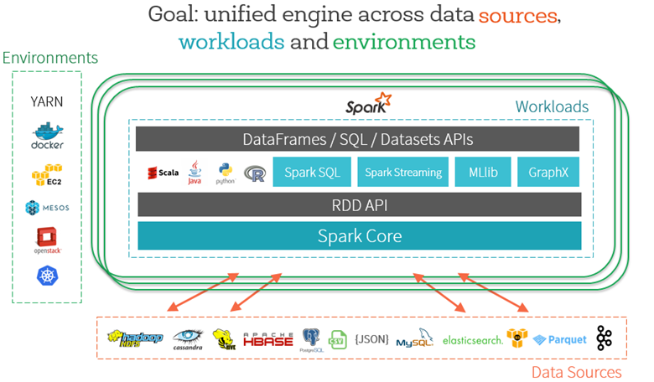
Source: Databricks

Slide 17
Why is MapReduce and variants not efficient?
“These systems are built around an acyclic data flow model” [1]
The application runs a “series of distinct jobs, each of which reads data from stable storage and writes back to stable storage” [2]
“Significant cost loading the data on each step and writing it back” [2]

Slide 18
Solution to Too Much Data Movement
Resilient Distributed Datasets (RDDs)
“RDDs can be stored in memory between queries without requiring replication” [2]
“Fault tolerant, parallel data structures that let users” [6]
“Explicitly persist intermediate results in memory”
“Control their partitioning to optimize data placement”
“Manipulate them using a rich set of operators”
Thus, the main feature of Spark is its in-memory cluster computing

Slide 19
RDD Dataflow
RDD
RDD
RDD
HDFS
Load
Map
Reduce
Load
Map
HDFS
Reduce
Lineage:
Load
Map
Reduce
HDFS
RDD
RDD
RDD
Based on Source Graphic by Earl Lawrence

Slide 20
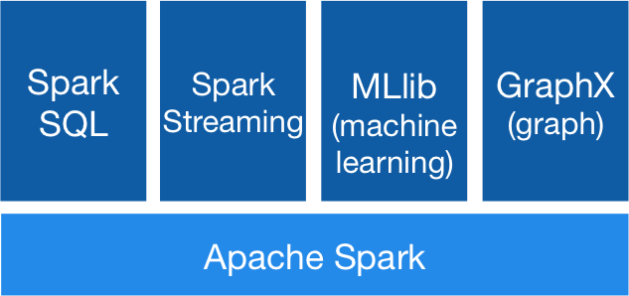
Generality
Spark was built with the idea of supporting a wider class of applications
Java, Scala, Python, R, and SQL
Apache Spark Libraries [2]

Slide 21
Using Spark

Slide 22
Submitting Spark Jobs
./bin/spark-submit \ --class <main-class> \ --master <master-url> \ --deploy-mode <deploy-mode> \ --conf <key>=<value> \ ... # other options <application-jar> \ [application-arguments]
Scala: package code into jar using sbt or maven
Python: “--py-files” argument to add python files
Example:
spark-submit --class Main --master yarn --deploy-mode cluster --driver-memory 115g --executor-memory 115g --conf spark.driver.maxResultSize="0" rsvdtest.jar mtxr matrix_10k.mtx 10 $HOME//rsvdtest/output_10k.txt 1 3
More: https://spark.apache.org/docs/latest/submitting-applications.html

Slide 23

SBT
Directory Structure:
example-project
|--build.sbt
|--main
|--scala
|-- Main.scala
Scala Interactive Build Tool
Commands:
sbt ~run
sbt package
build.sbt
name := “Example-Project”
version := “1.0”
scalaVersion := “2.11.8”
libraryDependencies += groupId %% artifactId % revision
Example library dependency:
libraryDependencies += "org.apache.spark" %% "spark-core" % "2.3.0"
libraryDependencies += "org.apache.spark" %% "spark-graphx" % "2.3.0"
libraryDependencies += "org.apache.spark" %% "spark-mllib" % "2.3.0"
https://www.scala-sbt.org/index.html

Slide 24
Using Shell
> pyspark
> spark-shell
These already have SparkContext created as “sc”

Slide 25
Programs will require creating sc in the file
Python
from pyspark import SparkConf, SparkContext conf = SparkConf().setMaster("local").setAppName("Test_App") sc = SparkContext(conf = conf)
Spark
import org.apache.spark.SparkContext._
import org.apache.spark._
val conf = new SparkConf() .setAppName("RandomSVD") val sc = new SparkContext(conf)

Slide 26
Standalone mode
Good for debugging and running jobs locally before interacting/batch with Bridges
Example command:
spark-submit --class Main --master local target/scala-2.11/rsvdtest_2.11-1.0.jar mtxr paperP.mtx 3 output.txt 1 3

Slide 27
Installing PySpark on Windows
Install Java JDK
Add JAVA_HOME environmental variable
Install Python 3
Select option to add Python to PATH
Download a Hadoop Binary (Windows specific issue)
Recall that Spark uses HDFS to work with files rather than NTFS like Windows
Extract to any directory ..\Hadoop
Create a HADOOP_HOME environment variable pointing to the installation folder
Add %HADOOP_HOME%\bin to the Windows Path variable
In command line: pip install pyspark

Slide 28
Scala Spark
Installed similarly, differences include
Download a prebuilt Spark version
Extract to a Spark folder
Create a SPARK_HOME variable
Add %SPARK_HOME%\bin to PATH
Spark-shell and spark-submit will now work on command prompt
Full list of instructions: https://medium.com/@josemarcialportilla/installing-scala-and-spark-on-windows-249632e6b83b

Slide 29
Examples

Slide 30
Example: Simple Counting
rdd= sc.textFile(“shakespeare.txt”)
rdd.count() #number of lines
words= rdd.flatMap(lambda x: x.split() )
words.count() #number of words
words.distinct().count() #number of distinct words
word_counts= words.map(lambda x: (x,1)) #create an rdd of tuples
.reduceByKey(lambda x,y: x+y) #reduce tuples by word
result= word_counts.map(lambda x: (x[1], x[0])) #swap key and value
.sortByKey(False) #sort by key, descending
result.take(5) #collect the top 5 (count, word) pairs

